Slide 1
Educating Deaf and Hard of Hearing Children in Colorado: Reflections
Cheryl DeConde Johnson, Ed.D.
The ADEvantage Consulting
CDE Consultant (1990-2006)

Slide 2
Landmark Events
1973 - 1990
1973-CHIP
1980-FAMILY Assessment
1989-Audiology Guidelines (1993, 2004)
1988-DHH Program Guidelines (1993, 2004)
1988-First Annual DHH Teacher Seminar
1990-CSDB Audit
1990-CO Cochlear Implant Consortium
1973-1990

Slide 3
Landmark Events
1990 - 1999
1990-CIPP (1993, 2002; Pre-CIPP, 1993)
1990-HI Family Support Network
1995-Colorado Resource Guide (98, 02, 04, 06, 08, 11)
1996-DOIT Center Educational Interpreter Training Program
1996-MCH Grant – Newborn Hearing Screening, Assessment, & Intervention (MDNC)
1997- Hands & Voices
1990-1999

Slide 4
Landmark Events
2000 - 2012
2000-RAS partnership established (ASK-12)
2000-02: CO Blueprint for Closing the Gap
2000 Educational Interpreter Guidelines (02, 04, 12)
2000-present: CU on-going research
2001-06: AZ-CO Longitudinal Study of Public School DHH Students
2003-06: Deaf Ed Reform Implementation
2003-Marion Downs Hearing Center
2012-CDE Eligibility Revision
2000-2012

Slide 5
Colorado Legislation
1991 – CSDB authority expanded to include Outreach
1996 – Deaf Child’s Bill of Rights
1997 - Newborn Hearing Screening
2000 - Educational Interpreter Standards
2000 – Colorado Commission of the Deaf/Hard of Hearing
2003 – CSDB autonomous authority
2004 – ASL is an official foreign language
2007 - Hearing Aid Insurance

Slide 6
Advocacy
Technology
Parent Partnerships
Amplification & assistive listening devices
Early intervention
Data-driven
Early identification
Assessment & interpretation
Role models

Slide 7
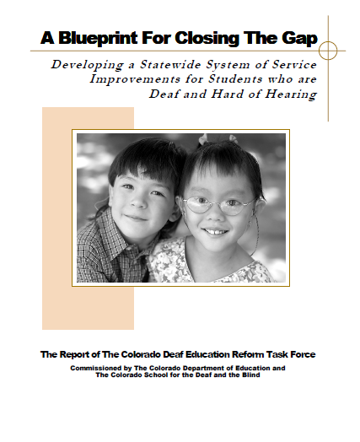
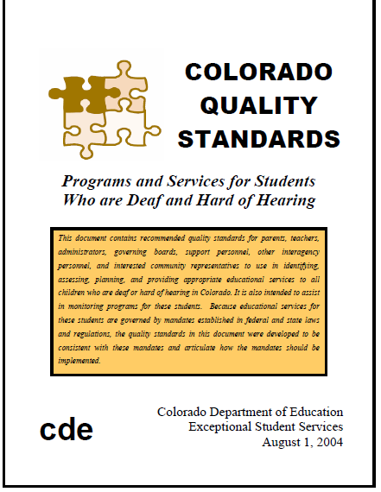
CO Deaf Ed Reform Activities
  Phase I. Blueprint for Closing the Gap
  [2000-01 to 2001-02]
  Phase II. Quality Standards, Accountability, Funding Options [2002-03]
  Phase III. Pilots (Pikes Peak, & Western Slope), Statewide Assessment on Quality Indicators [2003-04 to 2005-06]

Slide 8
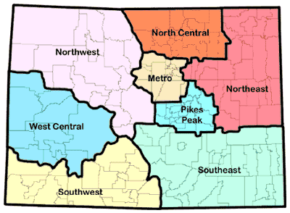
154
35
787
19
172
49
CSDB
139
25
61
Proposed Regional Program Model
CSDB Satellite Offices (Greeley, Denver, Glenwood Springs, Pueblo)

Slide 9
Satellite Office Staff/Responsibilities
Staff
Regional Administrator
CO-Hear Coordinator
Parent Liaison
Service Providers
  Mental health counselors
  Transition coordinator
Consultants/Coaches
  ELL
  Educational Interpreting
  Sign Language
  Oral Communication
  New and continuing teacher support
  Other related services support
Responsibilities
Administration and supervision of service providers (TOD, Educational interpreters)
Direct services
Consultation
Mentor/coaching
Parent support

Slide 10
Sample Regional Cooperative Program Model:
Northeast Colorado
Ft. Collins (37)
NE BOCES (8)
Windsor(3)
Sterling (3)
Estes Park (1)
Greeley
University Schools Charter (66)
Ft. Morgan (2)
Loveland(27)
Centennial BOCES (14)
Consulting D/HH teacher
D/HH – home school only
D/HH – resource/center-based
D/HH – center-based/Regional Program
Ft. Lupton-Keenesberg (3)
Support & Outreach
Student option to attending Regional Program
6/3/05

Slide 11
State Delivery Systems for Students who are Deaf and Hard of Hearing

Slide 12
IDEA Part C IDEA Part B
State Systems Organizations
Department of Health
State Part C
School(s )for the Deaf/Outreach
Local Part C programs
Department of Education
Regional
Cooperatives
Local School Districts
School(s ) for the Deaf/Outreach
EHDI
Other entities
Private & public centers
Therapy providers
Other entities
Private Schools
Therapy providers

Slide 13
IDEA Part C IDEA Part B
Model 1. Schools for the Deaf in Predominant Role
Department of Health
State Part C
School(s) for the Deaf/Outreach
Local Part C programs
Department of Education
Regional
Cooperatives
Local School Districts
School(s )for the Deaf/Outreach
EHDI
Other entities
Private & public centers
Private Schools
Therapy providers
Parent Advocacy

Slide 14
1a – ASDB: School for the Deaf with Satellite Day School, Regional Cooperatives and EI
Department of Education
Day School for the Deaf
Residential School
AZ Schools for the Deaf /Blind
Governor’s Office
Local School Districts
Regional Co-ops
Early Intervention (birth-3)
Department of Health
EHDI
All outreach programs managed by ASDB
  Hiring, supervision, staff development, pay
  Early intervention program statewide
Co-ops housed in local school district facilities
Co-ops are also resource centers for region
Local districts pay for service
Larger school districts have their own programs
Limited role by department of education
  Educational Interpreting
  Technical assistance
  Policy/Compliance

Slide 15
1b – UTAH: School for the Deaf with EI, Residential, Day School, Magnet, Outreach Services
Utah Schools for the Deaf/Blind
Utah State Board of Education
Utah Department of Health
Local School Districts
Child Find (Birth -3)
Programs (3-22) (LSL or ASL/English)
Parent Infant Program
Campus (Ogden & SLC)
Magnet (housed in LEAs)
Itinerant Outreach Services
EHDI
USDB/Outreach
  USDB representative attends ALL initial IEP/504 meetings in LEAs
  USDB designated as a related service provider on the IEP or 504 plan for students served in home LEA (“itinerant outreach”), fee for service
  Technical assistance, consultation and professional development provided statewide at not charge to school districts
  Required to report (1) academic achievement data, including longitudinal, for both current and previous students served by USDB, (2) graduation rates, & (3) placement after exiting USDB
Larger school districts may have their own programs
Limited role by department of education

Slide 16
IDEA Part C IDEA Part B
Model 2. State Departments in Predominant Role
Department of Health
State Part C
School(s) for the Deaf /Outreach
Local Part C programs
Department of Education
Regional
Cooperatives
Local School Districts
School(s )for the Deaf/Outreach
EHDI
Other entities
Private & public centers
Private Schools
Therapy providers
Parent Advocacy

Slide 17
PA: Department of Education, Regional Co-ops
Department of Education
Intermediate School Districts
Local School Districts
Regional Technical Assistance Centers
PATTan
Approved Private Schools/ Charter Schools for the Deaf
Department of Health
EHDI
Department of Public Welfare
Office of Child Development & Learning
Bureau of EI Services (Birth-5)
Regional and statewide services under Department of Education through Training and Technical Assistance Centers
  Staff development
  Technical assistance
IUs provide programs and services to students in local school districts
  Assessment
  Consultation
  Assistive technology
  Direct services
  Peer-social events by region
Additional outreach services by schools for the deaf (by request and fee-based)
Educational Resources for Children with Hearing Loss (ERCHL) Advisory Committee guides school-age services
EI services by contracted providers through Bureau of EI Services

Slide 18
IDEA Part C IDEA Part B
Model 3. Shared Roles DOE/DOH and School for the Deaf
Department of Health
State Part C
School(s) for the Deaf/Outreach
Local Part C programs
Department of Education
Regional
Cooperatives
Local School Districts
School(s ) for the Deaf/Outreach
EHDI
Other entities
Private & public centers
Private Schools
Therapy providers
Parent Advocacy

Slide 19
3a – CO: Shared Models
Department of Education
DHH Outreach Services
BOCES /Local School Districts
Department of Heath
EHDI
School for the Deaf/Blind
Outreach Services
DHH Early Intervention Program
Department of Human Services
Part C
Outreach services by Department of Education
  Technical assistance
  Professional development
  Policy/Compliance
  Educational interpreting
  Educational audiology
Outreach services by CSDB
  Assessment
  Consultation
  Assistive technology
  Direct services
  Peer-social events by region
Early intervention program by CSDB
Co-ops (BOCES) collaborate to share and provide programs and services (not part of school for the deaf
Statewide leadership team in deaf education to guide services (DOE, CSDB)

Slide 20
3b – TX: Shared Models
Texas Education Agency
Educational Resource Center on Deafness
Regional Education Service Center
School for the Deaf
Regional Day School Programs for the Deaf
Local School Districts
Department of Assistive and Rehabilitative Services – Early Childhood Intervention
Department of State Health Services
EHDI
State Leadership Team manages efforts of education agency and school for the deaf programs
Regional and statewide outreach services by Department of Education
  Technical assistance
  Professional development
  Educational Interpreters
  Educational audiology
  Policy/Compliance
Education agency oversees regional day school program system
Outreach services by school for the deaf

Slide 21
IDEA Part C IDEA Part B
Model 4. Statewide Center for Deaf/Hard of Hearing Children
Department of Health
State Part C
School(s) for the Deaf/Outreach
Local Part C programs
Department of Education
Local Districts/ Cooperatives
Statewide Center
School(s ) for the Deaf/Outreach
EHDI
Other entities
Private & public centers
Private Schools
Therapy providers
Parent Advocacy

Slide 22
4a – WA: Statewide Center
Governor’s Office
Center For Childhood Deafness & Hearing Loss
Statewide Outreach Team
Office of the Superintendent of Public Instruction
Department of Early Learning
Department of Health
EDHHI
Early Support for Infants & Toddlers
Sensory Disabilities Services (WSDS)
Contracts with programs/ providers
County Part C
Washington School for the Deaf
WA Sensory Disabilities Services (WSDS) under Department of Education in conjunction with CDHL is primary point of contact for all DHH students in WA
CDHL Statewide Outreach Team provides range of services using contracted experts around the state:
  Training/professional development
  Consultation
  Technical assistance
  Assistive technology
  Educational interpreting
  Educational audiology
  Psychology
  Literacy
  Early intervention
  Modality specialists (ASL, SEE, LSL)
Fee-based direct instruction services are contracted with local providers (public or private)

Slide 23
4b – NH: Statewide Center
(no school for the deaf)
Department of Education contracts with Center (Project) to provide DHH services statewide
Center conducts data collection and reports to DOE
Center acts as single state resource for all information related to DHH
Consultation services provided to schools at no cost (exact services to be determined)
School districts may purchase services from Center; consultants are contracted by Center to provide:
  Assessment
  Training
  Technical assistance
  Assistive technology
  Data management
  Other services to be determined
School districts are encouraged to pool resources and work across district boundaries
Direct instruction services are usually not provided
Department of Education
NH DHH Education Project
Local School Districts
Department of Health & Human Services
Bureau of Developmental Services – Family Centered Early Supports & Services
Multi-Sensory Intervention through Consultation & Education (MICE)
EHDI

Slide 24
From the PAIN come the DREAM
From the DREAM come the VISION
From the VISION come the PEOPLE
From the PEOPLE come the POWER
From the POWER come the CHANGE
Peter Gabriel, Fourteen Black Paintings (1992)

